Slide 1
TensorFlow User Group Guide
Link: goo.gle/tfug-guide
Last Updated: July 28, 2020
Questions? Contact: tfug-help@tensorflow.org
Note: This deck is only shared with: community-organizers@tensorflow.org

Slide 2

TensorFlow Communities
TFUG Community Guidelines
TFUG Brand Guidelines
Online Event Guidelines
TFUGs OnAir
Content

Slide 3
TensorFlow Communities

Slide 4
TensorFlow User Groups (TFUGs)
Google Developer Experts (ML GDEs)
Special Interest Groups (SIGs)
ML Working Groups
TensorFlow Communities

Slide 5
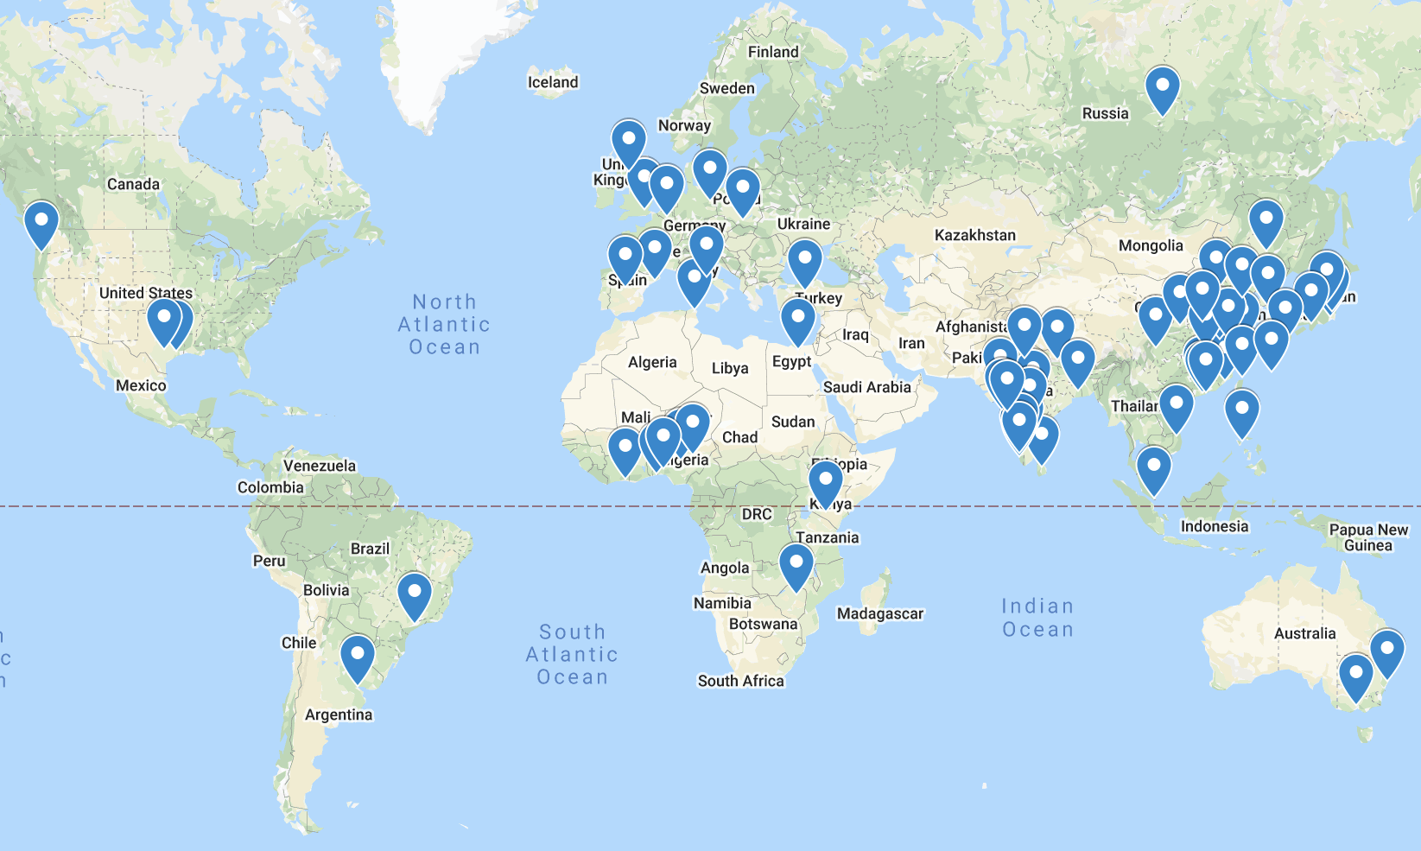
TensorFlow User Groups
70+ Groups
15+ Countries
TensorFlow User Groups (TFUGs) are communities of users (developers, engineers, data scientists, etc) who are passionate about TensorFlow and machine learning.
We aim to build and support a global network of TFUGs so like-minded people using TensorFlow and related technologies can exchange knowledge, information and best practices in addition to learning how to apply machine learning using TensorFlow.

Slide 6
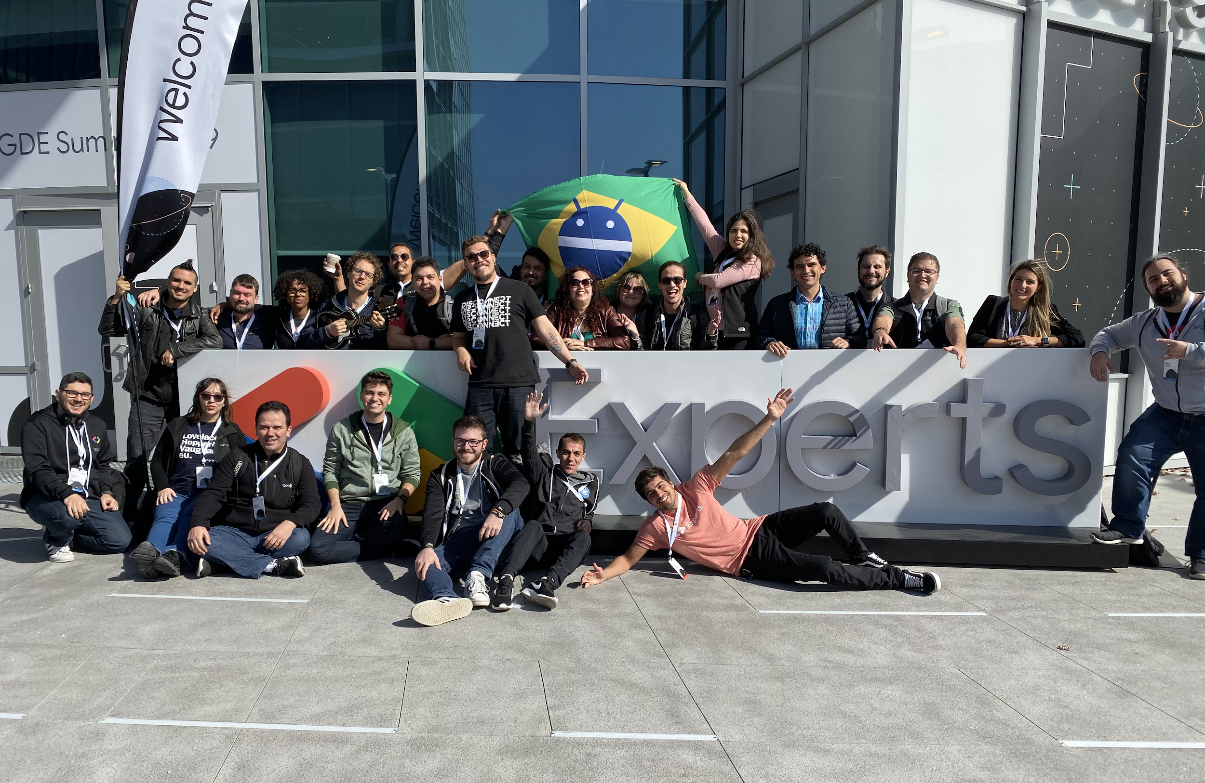
ML Google Developer Experts
150 ML GDEs
1,107 Public Presentations
The ML GDEs are a global network of Machine Learning experts and practitioners from the community, who work closely with Google, in order to advance machine learning education, usage and adoption worldwide.
These experts also play a critical role in technology development and community outreach.

Slide 7
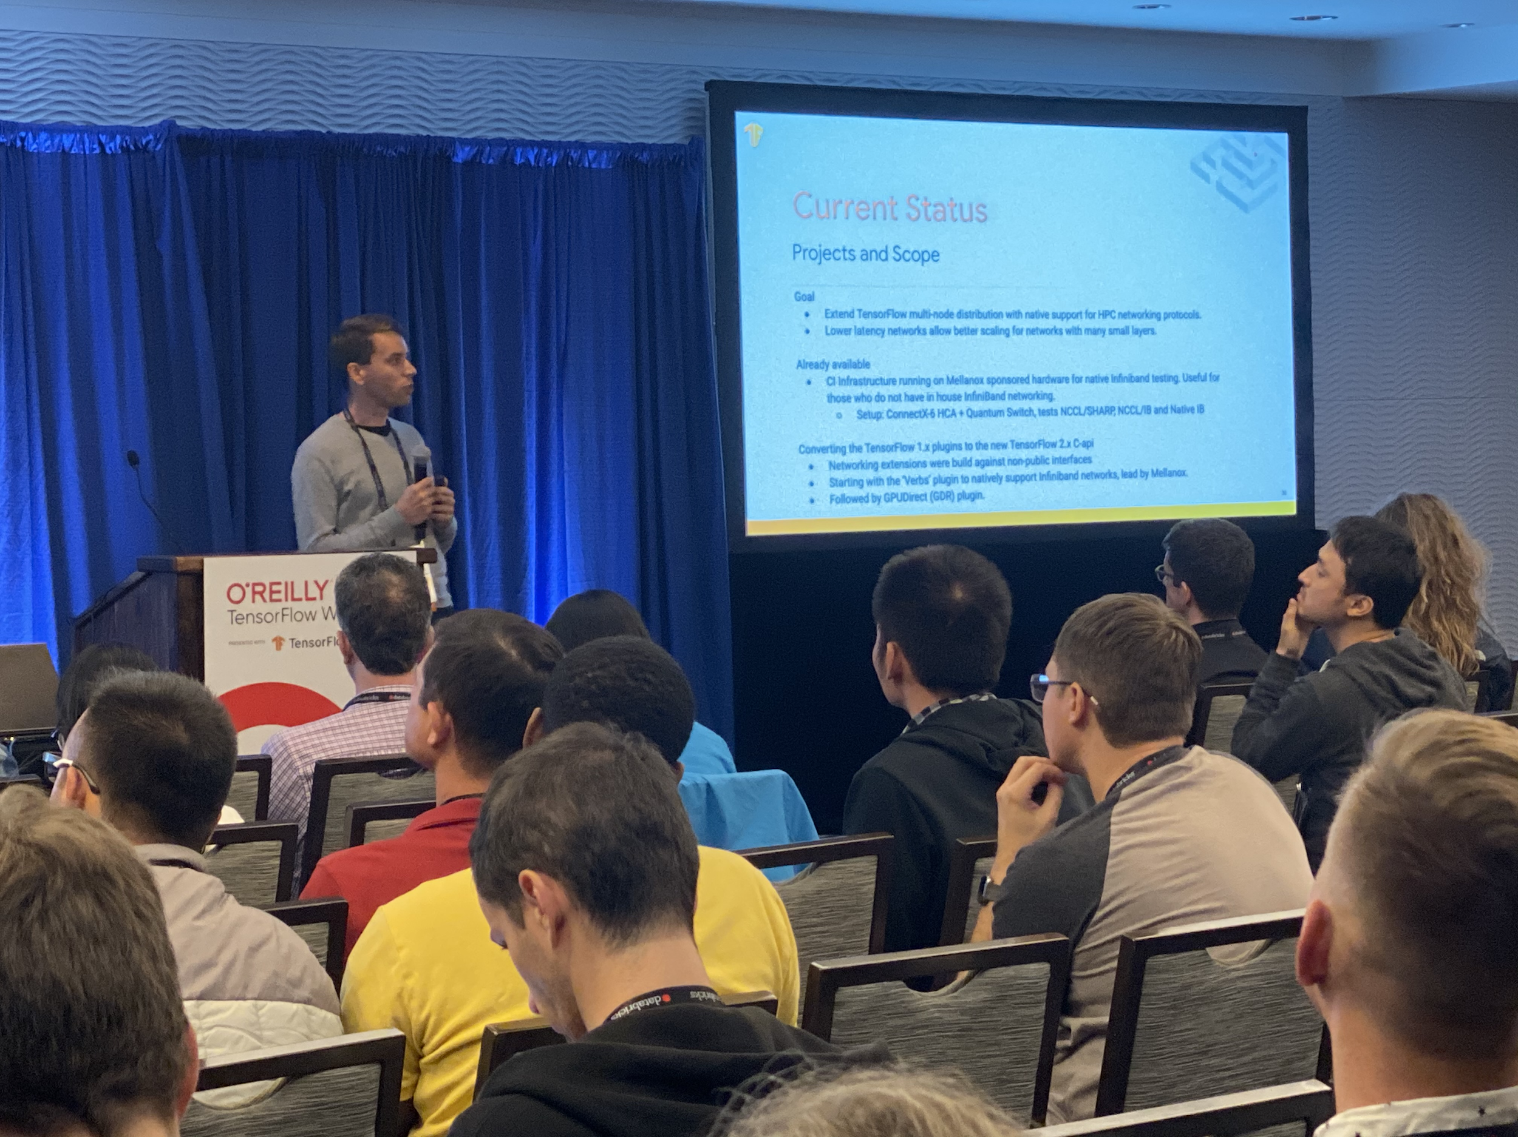
Special Interest Groups
12 SIGs
66 RFCs
The TensorFlow Special Interest Groups (SIGs) are groups of contributors with a defined project focus. These groups take ownership of specific areas to add and maintain new features.
Our contributor ecosystem includes the SIG Addons, Build, IO, Graphics, Networking, JVM, Micro, Rust, Keras, MLIR, Swift and TensorBoard.

Slide 8
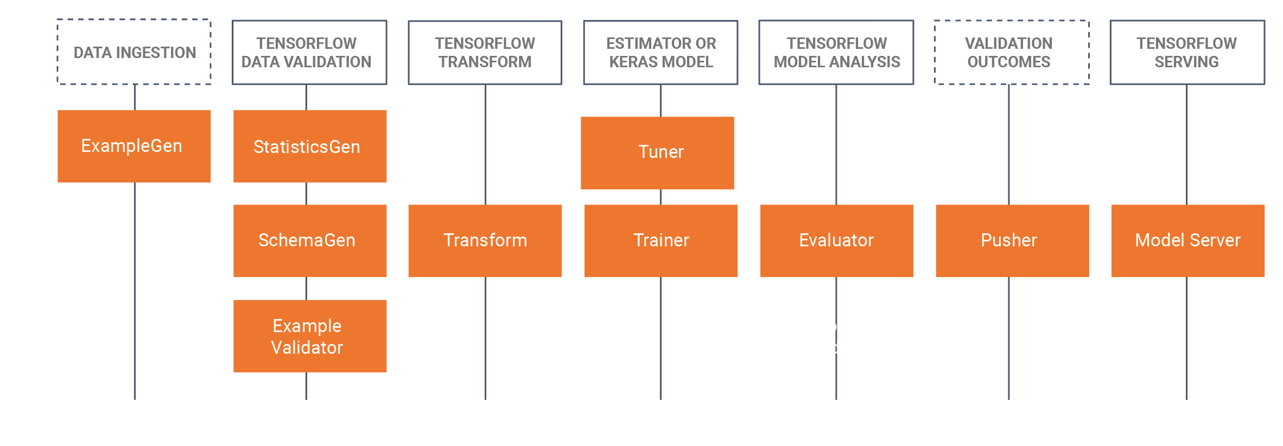
ML Working Groups
5 Working Groups
with Googlers and ML GDEs
ML Working Groups are group of Googlers, ML GDEs and TFUG organizers interested in specific ML related areas. It is a great place to discuss and share those topics and also seek like-minded people for collaboration.
Current ML WGs include MLOps WG, ML on Mobile OS WG, ML in JavaScript WG, Explainable AI WG, Diversity and Inclusion WG and more will be added.
The TFUG Organizer meeting note includes all the relevant information and link for each WGs.

Slide 9
TFUG Community Guidelines

Slide 10
Naming Guidelines
Focus Areas
Recommended Activities
Reporting
Content

Slide 11
Naming Guidelines
Do refer to your chapter as TensorFlow User Group [Geographic Name]
The geographic name should ideally be a city if there are more user groups exist in the same country
If yours is the only user group in your country, exception can be given to keep the name with the country name
DO NOT use the word “Google” in your name
DO NOT use the platform of your group in the name (ie: MeetUp)
The F in TensorFlow should always be capitalized
TensorFlow User Groups are a group of developers who meet physically or virtually in the form of meetups. Standalone whatsapp/facebook/telegram groups won’t be recognised.

Slide 12
Recommended Focus Areas
TFUGs can focus on the following areas:
TensorFlow Core Products (TF Library, TF.js, TF Lite, TF Extended)
TensorFlow and related products (e.g. JAX, TensorBoard)
Google Cloud products related with TensorFlow and ML(e.g. TPU, Colab)
Machine learning concepts (like Bias, Fairness etc.) and Domains like NLP

Slide 13
Community Communication
If you are not a part of community-organizers@tensorflow.org, please send an email to tfug-help@google.com
Attend the monthly TFUG Global Calls every third wednesday:
Asia/Europe at 1.30 PM IST
Asia/Americas at 6.30 AM IST
Meeting Notes here.

Slide 14
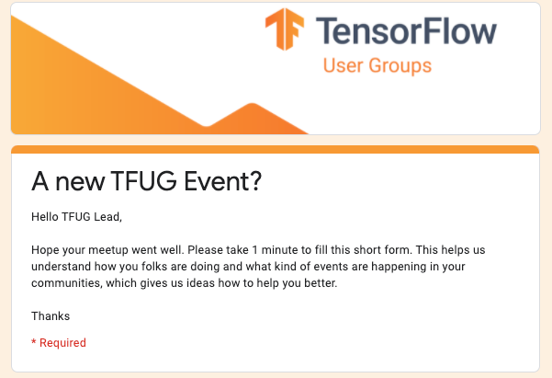
Report Events
Please fill bit.ly/tfug-form once you are done with an event/meetup. It takes less than a minute!

Slide 15
Brand Guidelines

Slide 16
Logo Creation
Branded Elements
Content

Slide 17
Be sure to follow our TensorFlow Brand Guidelines
Brand Book Instructions
Step 1
Create a logo for your TensorFlow User Group with your location name
*Be sure your name has been approved by tfug-help@tensorflow.org before submitting*
Step 2
Add your location specific logo into these templates

Slide 18
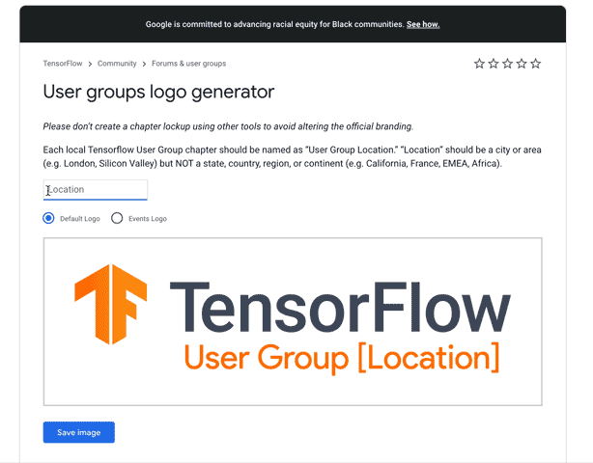
Logo generator here
Please do not share this URL with others.
*Be sure your name has been approved by tfug-help@tensorflow.org before submitting*
Logo Template

Slide 19




Download
Download
*Be sure your name has been approved by tfug-help@tensorflow.org before submitting*
Official Logos
Regular
OnAir
General
Location Specific
see next slide to create a custom logo for your location

Slide 20
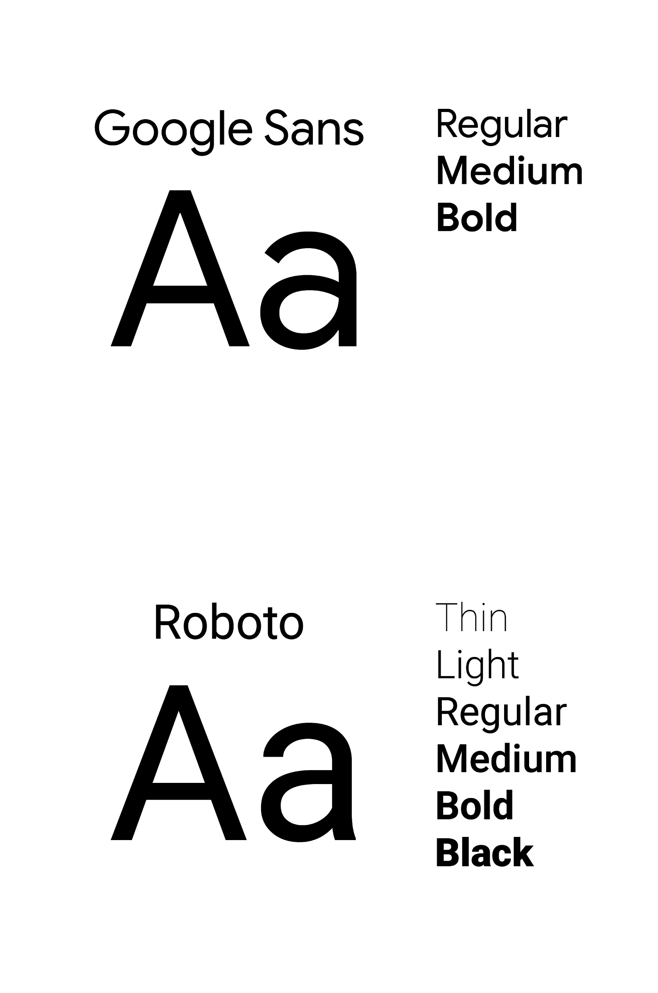


Google Sans Google Sans should be used in titles and headlines at sizes between 18pt and 35pt or 36pt and larger. Roboto Google Sans is paired with Roboto for long blocks of copy. We use Roboto for body copy, third-party content, footers, and utility features such as user input fields and for use at sizes smaller than 16pt.
Typography
DON'T use black text on an orange background

Slide 21
Either of these logos above can be used on any of the branded elements below.

Slide 22
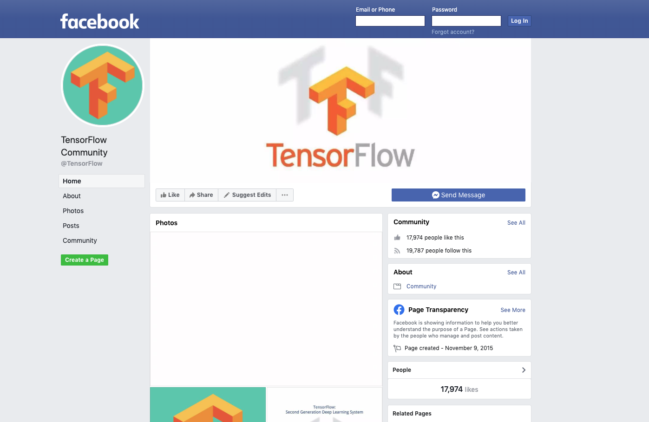
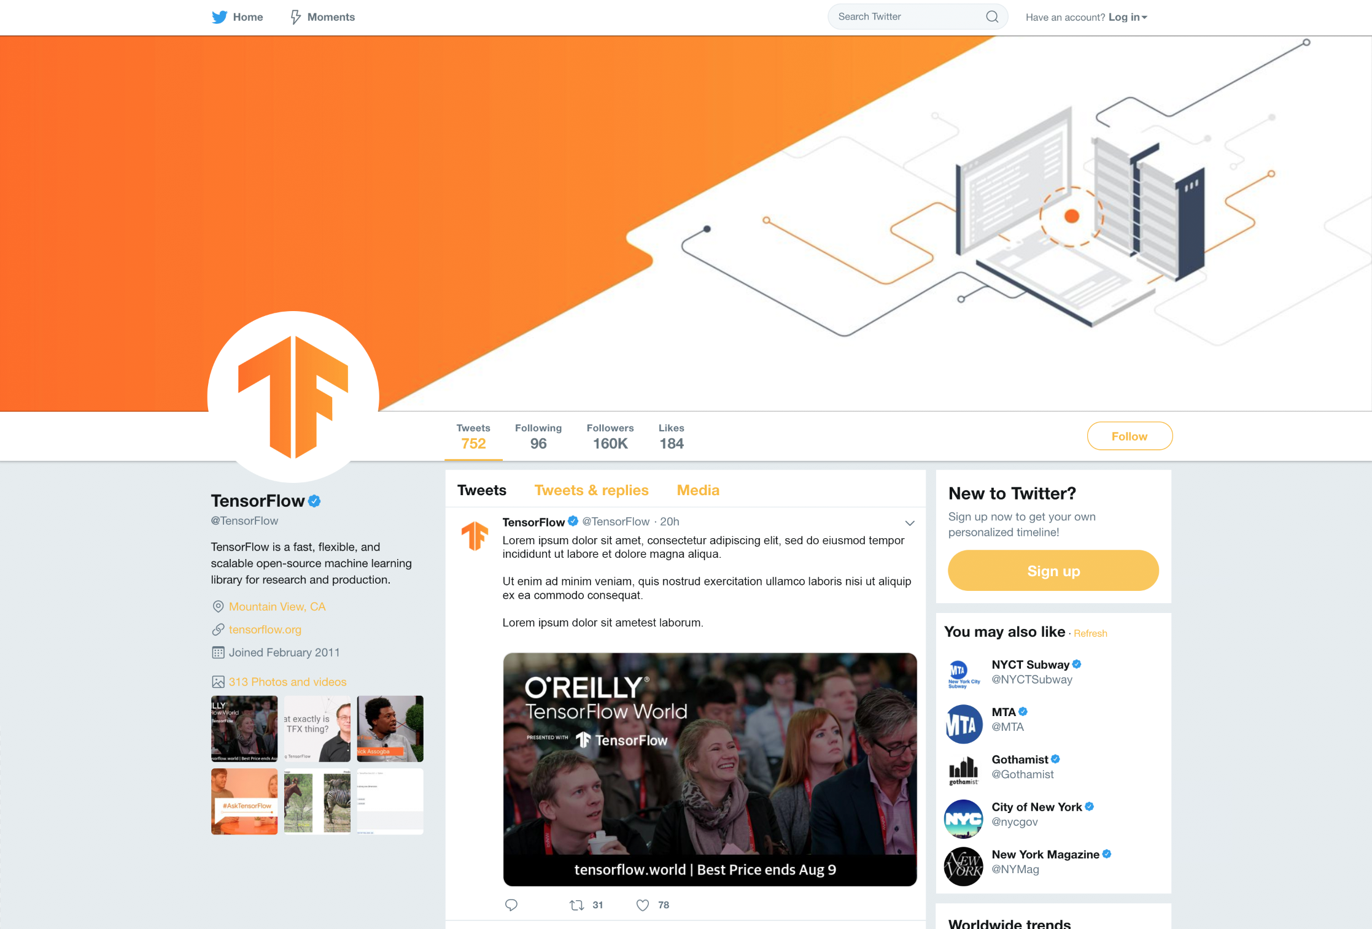


Download
Social Media Banner
Facebook

Slide 23


Download
Social Media Banner
Twitter

Slide 24
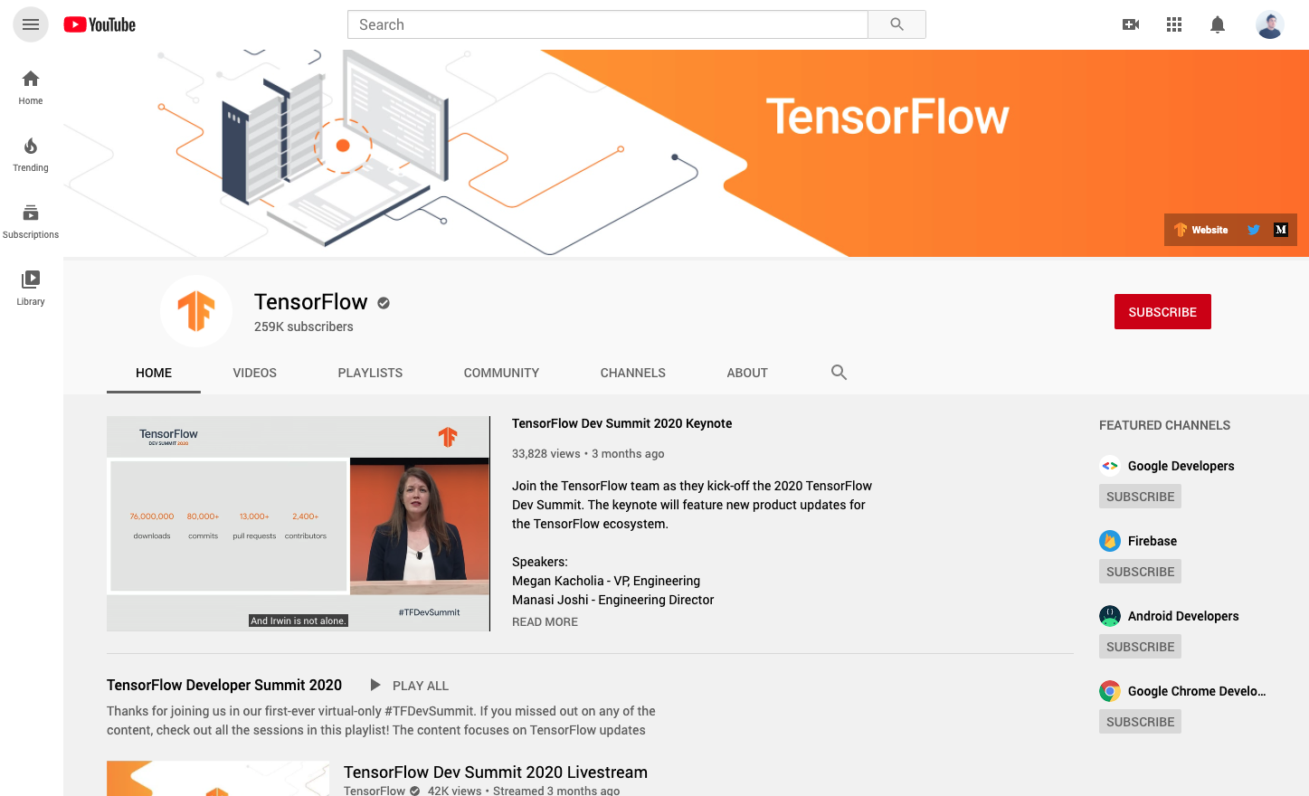

Download
Social Media Banner
YouTube

Slide 25
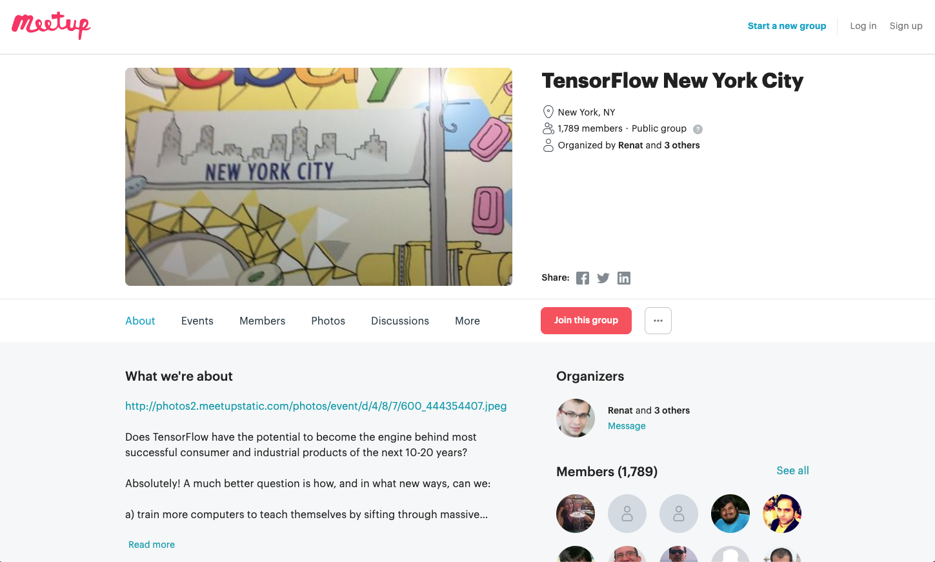

Download
Social Media Banner
MeetUp

Slide 26
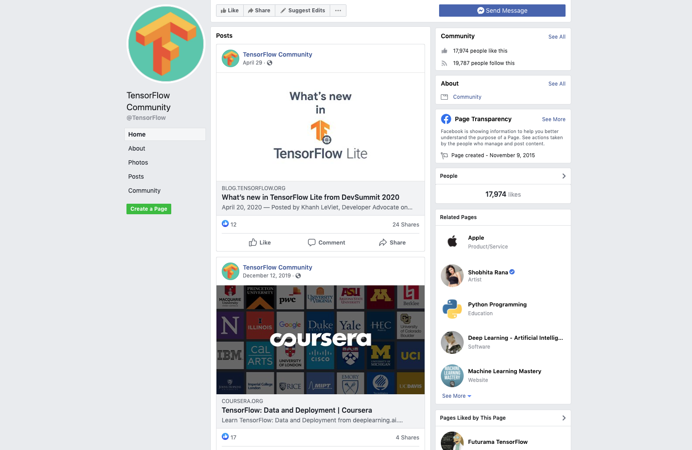
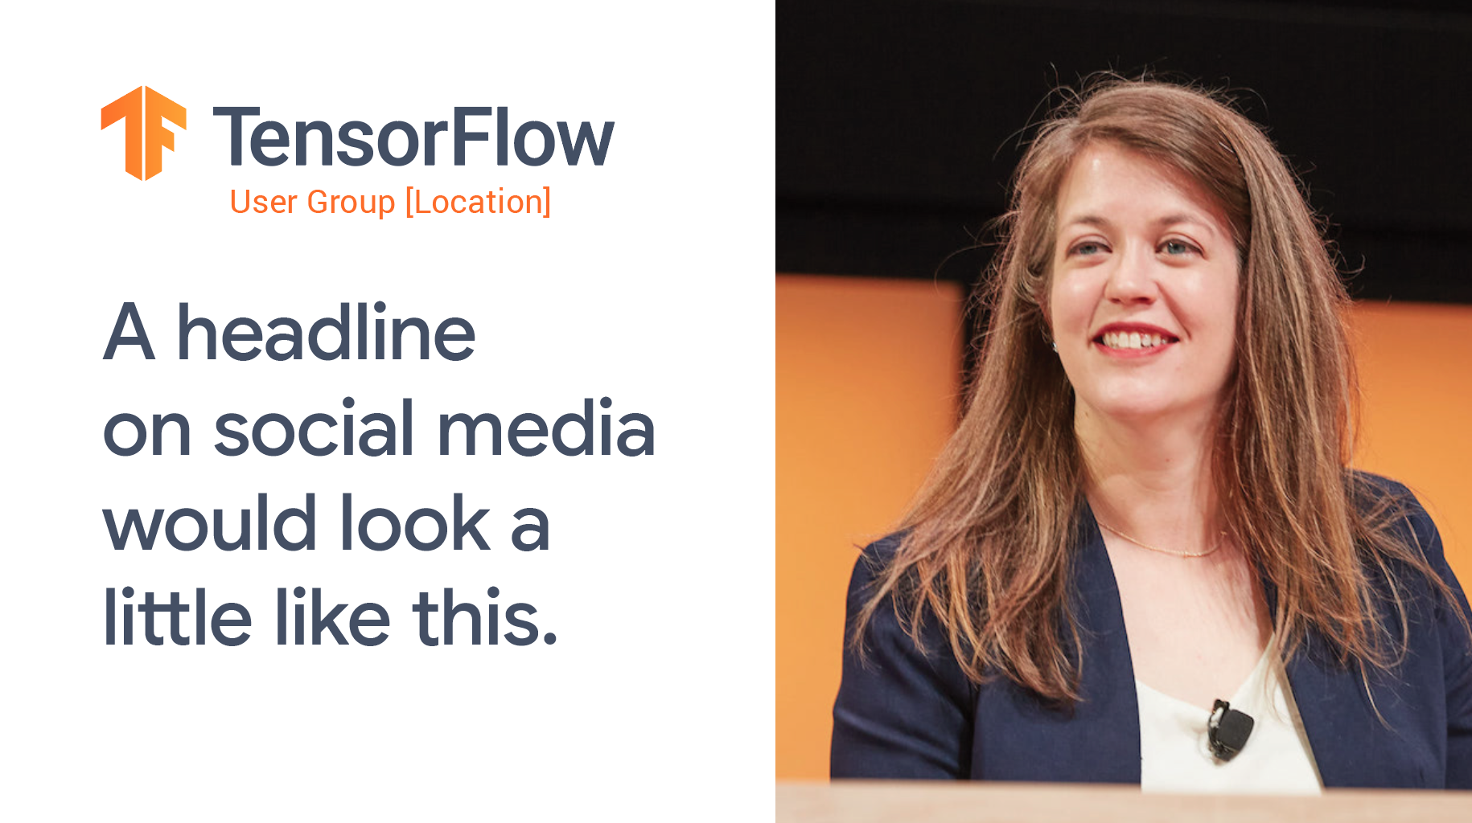

Download
Social Media Promo
Facebook

Slide 27

Download
Social Media Promo
Twitter

Slide 28
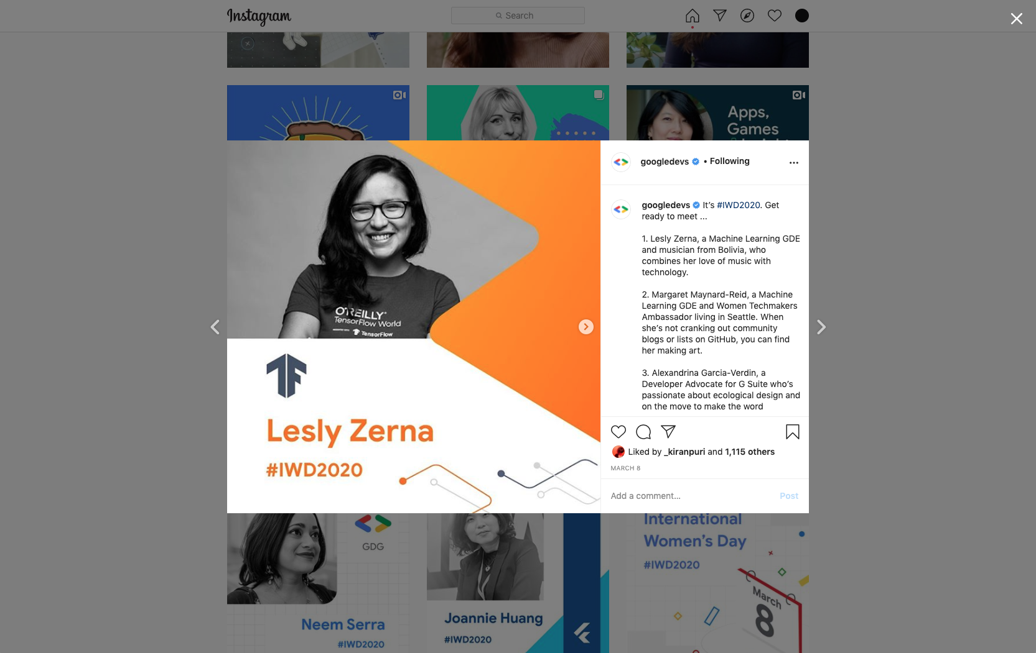


Download
Social Media Promo
Instagram

Slide 29


Download
Speaker Slide Deck

Slide 30
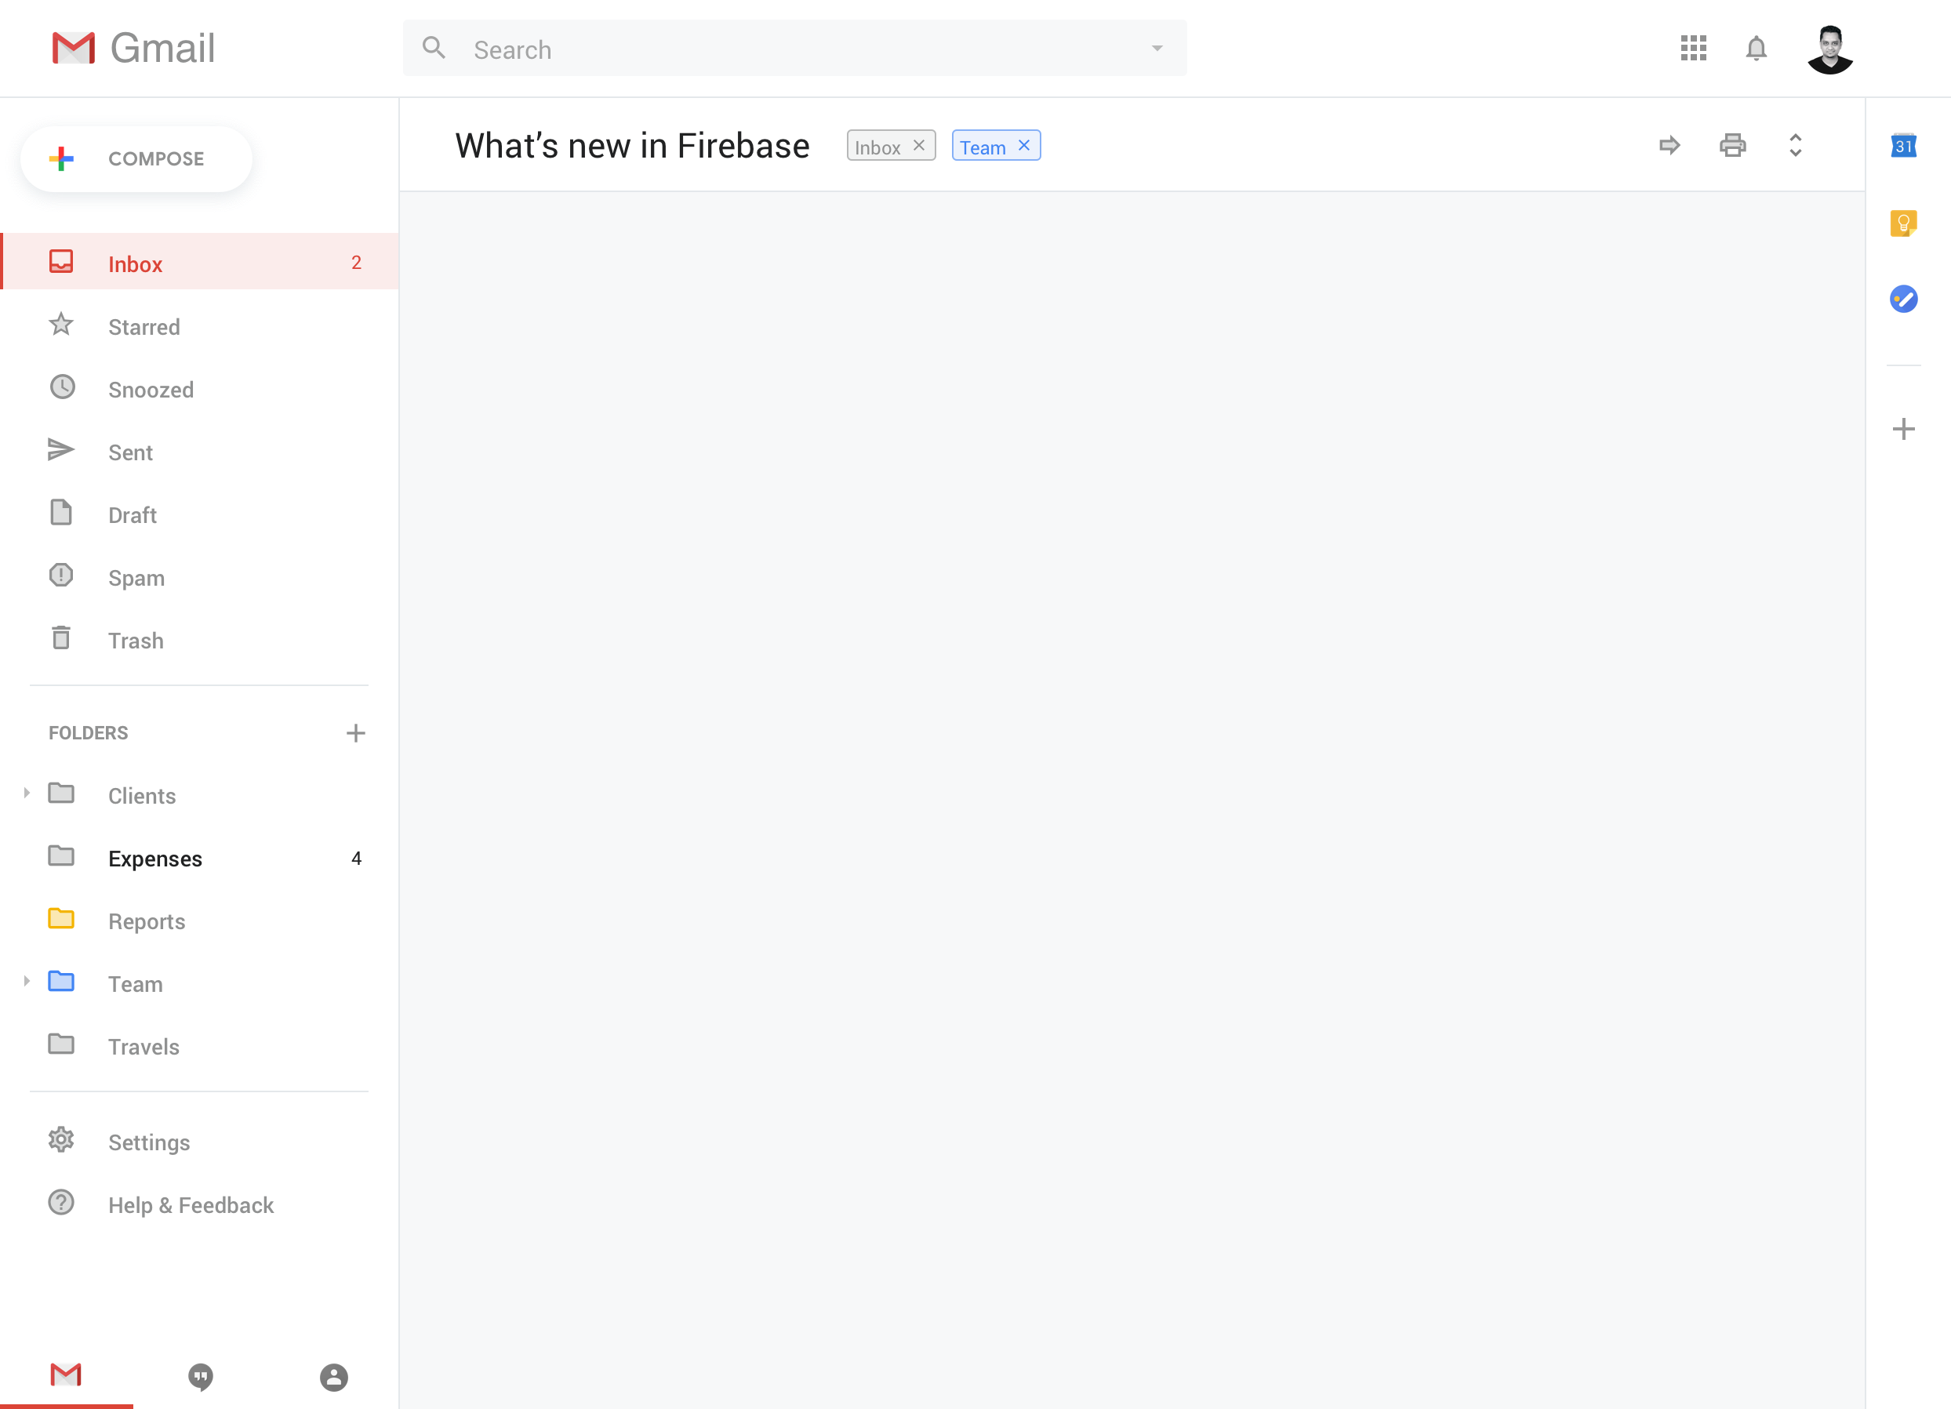
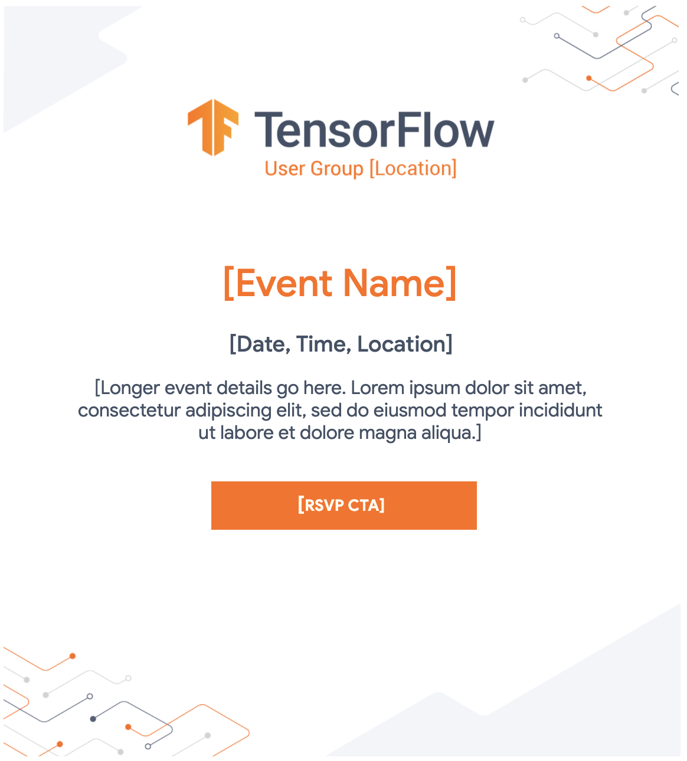
Download
Email Template

Slide 31
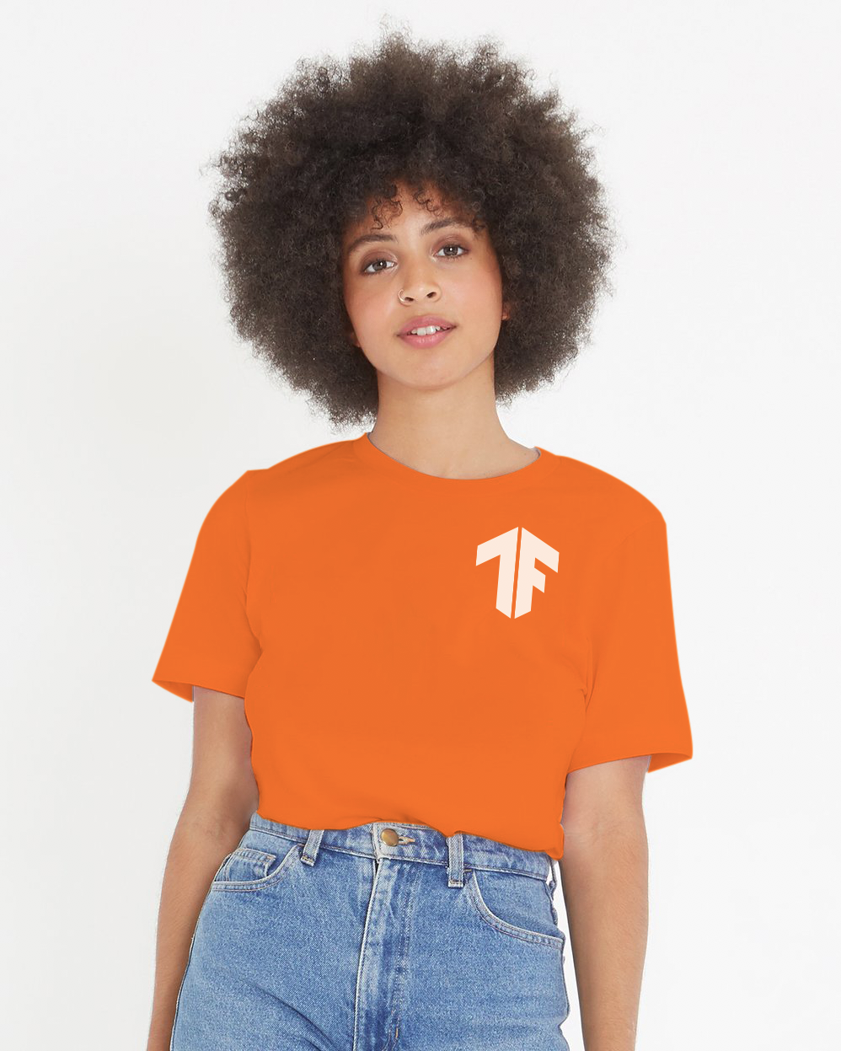

Please check with us
(tfug-help@tensorflow.org)
before bulk purchasing swag.
SWAG example

Slide 32
Online Event Guidelines

Slide 33
Event Planning Timeline
Before the Event
During the Event
After the Event
Content

Slide 34
Event Planning Timeline
Before the Event
During the Event
After the Event
Planning
Engagement
Setup
Hosting Platforms
Event Team Roles & Responsibilities
Time Guidelines
Sample Agenda
Best Practices
Post-event Follow-up Sample
Post-event Survey Questions Sample

Slide 35
Before the Event
Planning | Engagement | Setup
Set goals and objectives Understand your audience and their skill level Choose event format (workshop, Doc Sprint, Tech Talk) Decide on topic / product area(s) Schedule a date and time Allow at least 4-6 weeks for preparation Find speaker(s) Establish event team Create agenda | Send event announcement (at least 2 weeks before your event) Social Email Meetup page Send event invite link (1 week before your event) Send reminder email (24 hours before your event) Send post-event follow-up / survey | Choose the platform that works best for your region Google Meet YouTube Live StreamYard Facebook Live Zoom Feishu Tencent (Voov) Meeting Use a laptop / PC with a good camera and microphone Check and confirm platform settings Do a test run the day before to test out presentation, equipment, and internet speed

Slide 36
Hosting Platforms
 | Features | How to join | # of participants | Requirements | Resources
Google Meet | Unlimited meetings, live chat, multiple presenters | Invite | Up to 250 | Gmail account | Google Meet Playbook, Training and help
YouTube Live | Real-time livestream, live chat replay; recording options: web cam, mobile cam, encoder | Link | Unlimited | For mobile livestream, 1000+ subscribers on your channel | YouTube Live Playbook, YouTube Creator Academy
StreamYard | Live video studio in the browser, multiple platform integration | Link | Unlimited | Chrome, Firefox and Opera browsers. Free version is limited to 20 hours streaming per month | StreamYard User Guide, StreamYard Tutorial, Pricing
Facebook Live | Livestream on a Page, group, or event, live chat; recording options: Facebook mobile app or encoder | Link | Unlimited (public livestream) | Facebook account. Time limit: 8 hours on a computer / API and 4 hours on mobile. | Facebook Live User Guide, Tips for Facebook Live
Zoom | Video conference, content sharing, live chat, record locally or to the cloud | Link | Up to 100 (free) | Zoom account | Zoom User Guide, Pricing
Feishu | Livestream, content sharing, real-time collaboration, subtitle options, live chat, sync to other platforms | Link | Unlimited (public livestream) | Chinese mobile number | Feishu User Guide
Tencent (Voov) Meeting | HD video conference, content sharing, instant text messaging | Invite | Up to 100 (free) | Chinese mobile number | Sign up for Voov Meeting, Pricing

Slide 37
During the Event
Roles & Responsibilities | Time Guidelines | Best Practices
Host Ensures the event starts and ends on time, introduce ground rules and speakers Presenter / guest speaker Delivers content/training Chat Moderator Have at least 1 moderator to monitor live chat for questions from the audience. Help engage attendees with questions and comments | TFUGs OnAir: 2.5 hours max Workshops: 1-2 hours Meetups: 1-1.5 hours Q&A: 10 minutes or less at the end of each talk | Encourage attendees to ask questions in the live chat Allow time for Q&A after each talk Presenters should keep their camera on at all times Follow up on questions and unclear topics

Slide 38
After the Event
Post-event Follow-up Sample: Hi TensorFlow Community, Thank you for joining our first TFUGs OnAir event for TFUG [name] on [date]! In this event, we covered: [topic 1] [topic 2] Here are additional resources for you: [link] If you missed event, you can watch the recording here [link]. Please fill out this survey [link] to let us know more about your experience! Thank you, (Your name)
Post-event Survey Questions Sample: Did you find this event to be useful? Do you plan on attending more events in the future? What did you like most about the event? What topics would you like to learn more about? How can we improve for the next event? Send post-event survey to understand attendees experience and to find out more about what topics they’re interested in for future events.

Slide 39
TFUGs OnAir

Slide 40
About
Calendar
Logo
Invitation Comms
Keynote
Content Packs
Tensorflow Certificate
Content

Slide 41
About
In order to connect during these times, we are launching a new global series called TFUGs OnAir. These are locally organized virtual events by TFUGs (TensorFlow User Groups) with an aim to share the latest in TensorFlow, connect with the local community, and hear directly from the TensorFlow team, including time for live Q&A.
General CTA: Be sure to reach out to your local TFUG here for more information. We hope to see you at a virtual event soon!
Note: We are encouraging TFUGs in nearby locations to collaborate and host together.

Slide 42
Calendar of TFUG OnAir Events
An event series by Tensorflow User Groups virtually in November
Each event is expected to be between 90-150 minutes (maximum 2.5 hours)
Each community is free to choose the platform of their choice
More details on this is coming soon :-)

Slide 43
Logo
Logo Generator
Please do not share this URL with others.
These logos can be added to any of the formatted templates here.

Slide 44
TFUGs OnAir
Invitation Comms
Hi TensorFlow Community,
In order to connect during these times, we are participating in TensorFlow’s new global series called TFUGs OnAir. These are locally organized events by TFUGs (TensorFlow User Groups) with
an aim to share the latest in TensorFlow, connect with the local community, and hear directly from the TensorFlow team, including time for live Q&A.
Our TFUGs OnAir event for TFUG [Name/Location] will take place on [date and time].
This event will include:
A keynote to learn the latest in TensorFlow covering, XYZ
[topic 2]
[topic 3]
Come learn about TensorFlow, meet the community, and find out
how you can contribute!
RSVP for the virtual event here [link].
Thank you,
(Your name)
Send event announcement and include RSVP link using your prefered platform (Eventbrite, Facebook groups, Meetup.com, or Google form, etc) to keep track of how many people will be attending
Do not share event link directly on social media

Slide 45
TFUGs OnAir Keynote
A keynote deck will be added here with detailed talking points.
In terms of presenting, there are 3 options:
Play a pre-recorded version available in English & Chinese (will be added early November)
Use this deck and have a person of your choice present
Have your drop in TensorFlow member present the content live

Slide 46
Content Packs
2020 TensorFlow Dev Summit Slides
2019 TensorFlow Dev Summit Slides
https://www.tensorflow.org/learn
Tensorflow Youtube Channel
Machine learning Crash Course
More coming soon!

Slide 47

TensorFlow Certificate
The goal of this certificate is to provide everyone in the world the opportunity to showcase their expertise in ML in an increasingly AI-driven global job market. This certificate in TensorFlow development is intended as a foundational certificate for students, developers, and data scientists who want to demonstrate practical machine learning skills through the building and training of models using TensorFlow.
In order to successfully take the exam, test takers should be comfortable with:
Foundational principles of ML and Deep Learning
Building ML models in TensorFlow 2.x
Building image recognition, object detection, text recognition algorithms with deep neural networks and convolutional neural networks
Using real-world images in different shapes and sizes to visualize the journey of an image through convolutions to understand how a computer “sees” information, plot loss and accuracy
Exploring strategies to prevent overfitting, including augmentation and dropouts
Applying neural networks to solve natural language processing problems using TensorFlow
Exam cost $100 USD. Stipends are available.
TensorFlow.org/certificate

Slide 48
Thank you!
Questions? Contact: tfug-help@tensorflow.org

